Slide 1
Networking Fundamentals
Foundations of Ethernet and IP

Slide 2
Network Terminology
#
Need-to-know terms for success

Slide 3
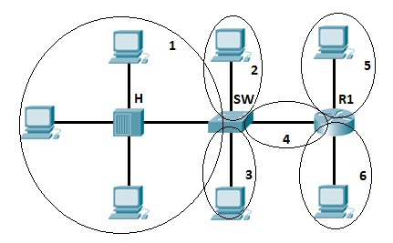
Physical – Collision Domain
When a device transmits, the entire wire’s voltage increases
A collision domain is a continuous electrically conductive wire. A hub connects multiple wires. A switch separates collision domains

Slide 4
Physical – Duplex
Duplex dictates whether a device may transmit and receive at the same time

Slide 5
Logical – Broadcast Domain
Where a hub physically connects multiple wires, a switch logically connects them
A switch uses information in the ethernet frame to re-transmit (forward) the information

